Slide 1
BlueKey: Exploiting Bluetooth Low Energy for Enhanced Physical-Layer Key Generation
Yawen Zheng，Fan Dang，Zihao Yang，Jinyan Jiang，Xu Wang，Lin Wang，Kebin Liu，Xinlei Chen，Yunhao Liu
Tsinghua University, Yanshan University
Notes:
Hello everyone. This is Yawen Zheng from Tsinghua University.
The paper I will be presenting today is titled “presenting BlueKey: Exploiting Bluetooth Low Energy for Enhanced Physical-Layer Key Generation .”
(My collaborators are Fan Dang, Zihao Yang, Jinyan Jiang, Xu Wang, Lin Wang, Kebin Liu, Xinlei Chen and my adviser, Yunhao Liu.)

Slide 2
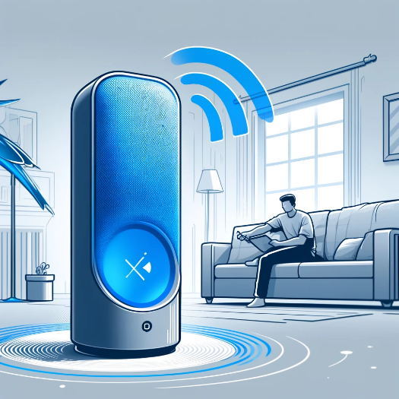
Introduction to BLE
Bluetooth Low Energy (BLE) has become a ubiquitous technology owing to its lower power consumption and compatibility with diverse devices
Fitness trackers
Smart locks
Wireless speakers
Laptop peripherals
Notes:
Today, Bluetooth Low Energy, or BLE, has become a ubiquitous technology
owing to its lower power consumption and compatibility with diverse devices
from fitness trackers that monitor our health to smart locks that secure our homes.
from wireless speakers that answer our request to laptop peripherals that support our work.
However, its widespread adoption also brings glaring security risks.

Slide 3
BLE Security
BLE provides the following four pairing methods
Numeric Comparison
Passkey Entry
Out-of-Band
Connection
degradation
Just Works
Cryptographic ECDH method ：
plaintext exchange of public keys
susceptible to eavesdropping and man-in-the-middle attacks
Required user intervention and
specific I/O capabilities of devices
Notes:
Traditionally, BLE provides four pairing methods:
Three of which require user intervention and specific I/O capabilities of devices.
For example, with the passkey entry method,
User sees the secret key generated on one device, and then manually input it into the other device.
Researchers have proposed attacks to degrade the pairing methods to the simplest “just works”
By faking a legitimate device that has no I/O interfaces.
In this way the cryptographic ECDH method is adopted, which exchange public keys in plaintext,
making it susceptible to eavesdropping and MITM attacks.

Slide 4
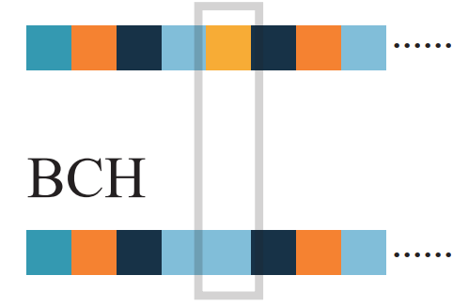
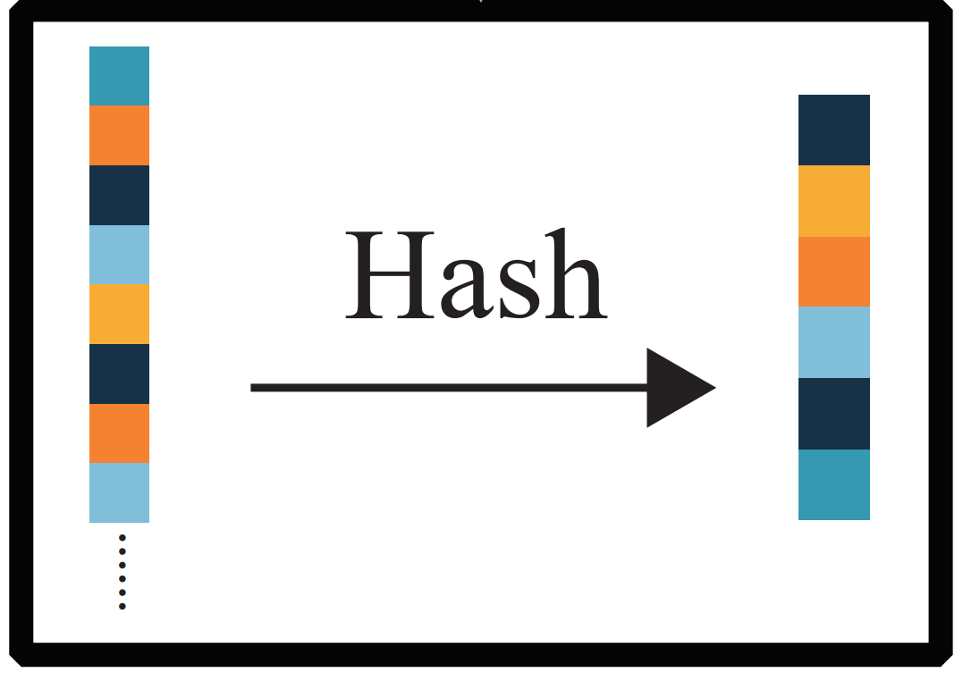
Physical-layer Key Generation
Channel reciprocity ensures generation of matched key
Temporal variability provides sufficient information
Spatial decorrelation prevents nearby eavesdroppers
Security
enhancement
extracting secret bits from physical-layer information.
Amplitude
01001101010100…
Q
Phase
I
Information
reconciliation
Privacy
amplification
Channel probing
Channel estimation
Quantization
Notes:
To enhance the security of existing solutions,
we consider using physical-layer key generation methods.
Which extracts secret bits from the physical-layer information of signals
and can serve as a complementary measure to traditional BLE security system.
It has three main characteristics:
Channel reciprocity ensures generation of matched key
Temporal variability provides sufficient information
And Spatial decorrelation, which prevents nearby eavesdroppers.
The mainstream PKG methods involve the following steps: first is Channel Probing step,
Then in Channel Estimation step physical-layer features are extracted from the probing signals.
In Quantization step, these features are converted into a long sequence of 0/1 bits.
In Information Reconciliation step, mismatched raw bits are modified with error-correcting codes.
In Privacy Amplification step, bit sequences are compressed into a secret key using hash functions.
The last two steps are generally consistent across methods.
The main differences lie in how the signals are probed and estimated,
what physical layer characteristic information is extracted,
and how this information is quantized.

Slide 5
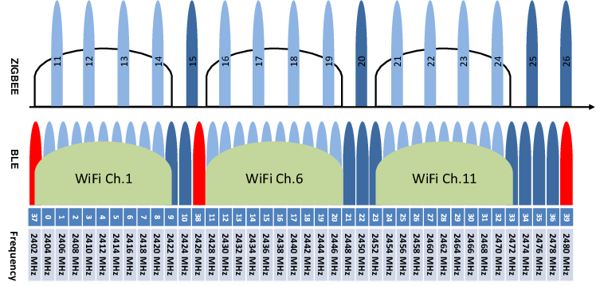
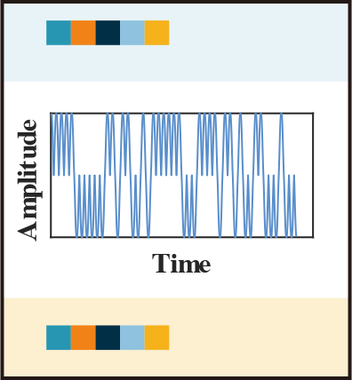
Unique Challenge in BLE
Raw key bits of Alice
RSSI-based PKG
BLE devices have low data exchange rates → low key generation rate.
Narrow communication bandwidth
BLE has a single channel width of 2 MHz
compared to WiFi's 20 MHz (at minimum).
Raw key bits of Bob
Notes:
Despite the promising exploration of PKG, previous research is often applied to WiFi devices, with little focus on Bluetooth.
This is because the narrow bandwidth and specific modulation techniques of BLE pose unique challenges to PKG implementation.
For instance, although BLE and Wifi signals both operate in the 2.4GHz ISM band (2.4 GHz - 2.48 GHz).
BLE uses 40 channels, each with only 2 MHz wide.
In comparison, WiFi has available channel widths ranging from a minimum of 20 MHz to a maximum of 160 MHz.
For RSSI-based PKG, this narrow communication bandwidth and consequent low data exchange rates of BLE will result in a low key generation rate.

Slide 6
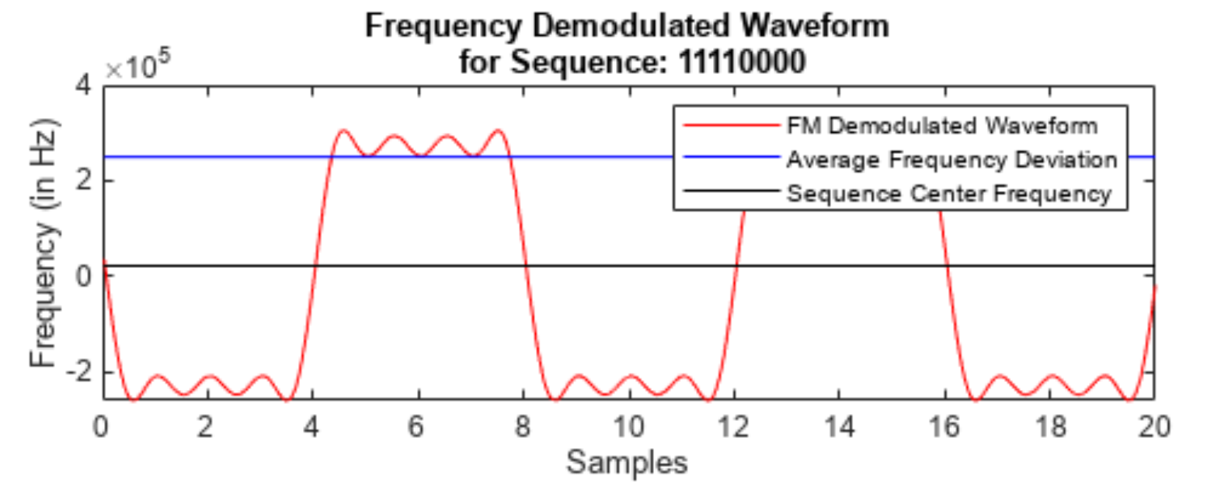
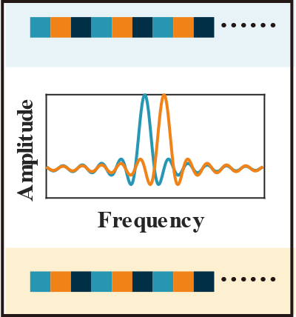
Unique Challenge in BLE
Raw key bits of Alice
CSI-based PKG
BLE signals have two frequencies → limited information entropy.
Limited modulation frequencies
GFSK uses 2 frequencies to represent 0 and 1
compared to OFDM's 64 subcarriers.
Raw key bits of Bob
Notes:
Besides, BLE uses Gaussian Frequency Shift Keying (GFSK) modulation,
where 0/1 bits are represented in two characteristic frequencies.
Meanwhile, WiFi uses Orthogonal Frequency Division Multiplexing (OFDM)
with 64 different frequency subcarriers.
Therefore, the limited information entropy provided by BLE modulation
complicates direct application of existing mainstream CSI-based PKG techniques
which is initially developed for broader Wi-Fi channels.

Slide 7
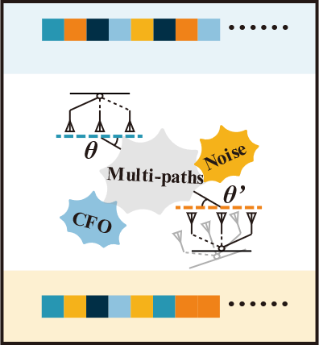
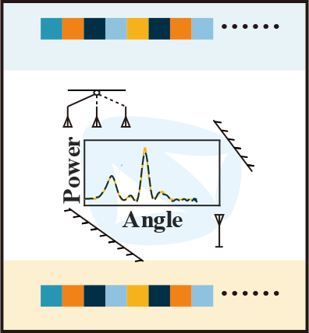
DoA-based BLE
Raw bits of Alice
DoA-based PKG
BLE direction-finding is not accurate enough, → high mismatch rate
extends the spatial dimension of CSI
Raw bits of Bob
Notes:
Building on this, we have also investigated some PKG work based on the direction of signals.
Unfortunately, the angle estimate capabilities of BLE are not accurate enough (due to bandwidth limitations hindering BLE's ability to handle multipath effects),
Which may lead to destructive key mismatches.
Nevertheless, the silver line is that we can introduce the direction finding process to extend the spatial dimension of CSI.
(Generally, CSI information has one dimension for different subcarrier frequencies and one for different antennas. )
Since BLE frequencies are difficult to expand as they are fixed in the protocols, it is feasible to consider using different antennas for expansion.

Slide 8
BlueKey: System Overview
Notes:
To develop BLE-specific PKG methods, we proposed BlueKey, a novel exploiting BLE
to enrich the reciprocal information from the physical-layer and enable more effective key generation.

Slide 9
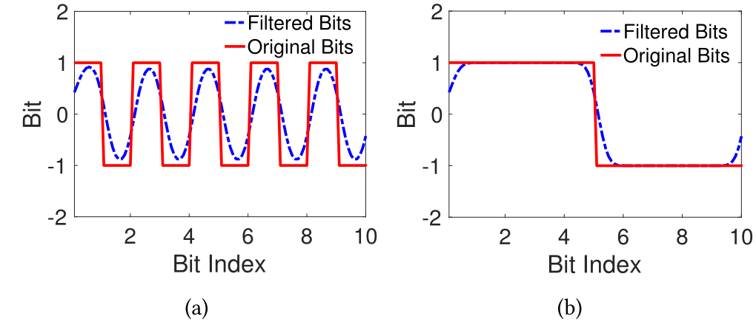
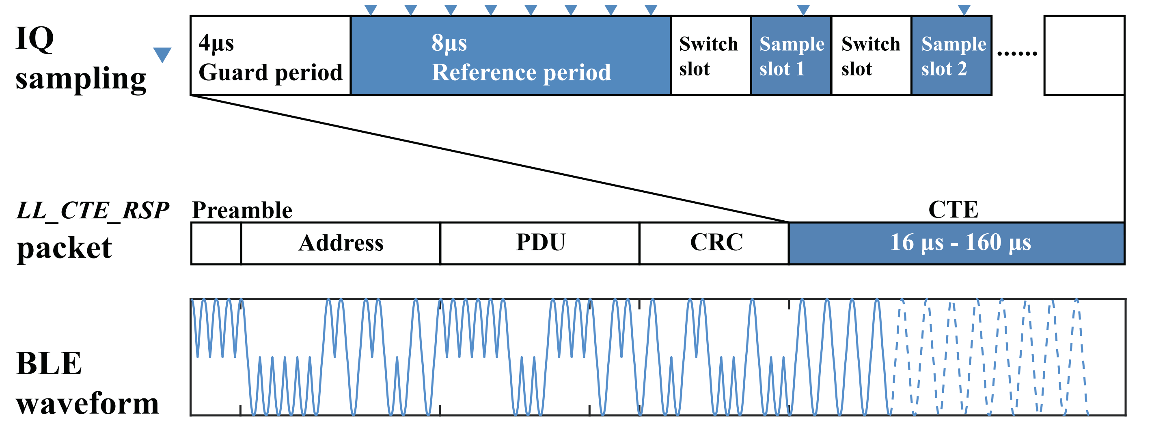
Constant Tone Extension (CTE)
Since BLE 5.1, the protocol has included the CTE (Constant Tone Extension) field for direction-finding
BLoc CoNEXT’18：
Using long 1/0 sequences forces the GFSK signal
frequency to converge, enabling the CSI measurement.
CTE (since 2019)：
A long sequence of 1s without data whitening (which ensures a balance of 1s and 0s).
Notes:
Bluekey takes advantages of the direction finding function introduced since BLE protocol 5.1,
with a specific-designed packet field called CTE, the Constant Tone Extension
Based on the idea of using long 1/0 sequences to force the GFSK signal frequency to converge,
CTE enables the CSI measurement of BLE.
as itself is a single-tone long sequence of bit 1s without data whitening.

Slide 10
BLE: Direction Finding
Ideally:
in Reality：
affected by multipath effects
(especially for narrow-band signals), carrier frequency offset (CFO),
and noise etc.
Although channel estimation is performed with direction-finding,
the key exchange itself does not require high accuracy but only reciprocity.
Notes:
For a direction finding antenna array,
ideally the phase difference of signals received by each pair of adjacent antenna should be identical,
Which is proportional to the wave-path difference caused by the geometry of the array.
With the measurement of phase difference, the direction of signals can be calculated.
However, in reality the phase difference is affected by multipath effects,
carrier frequency offset (CFO), and environmental noise.
Which is even severe for narrow bandwidth signals like BLE.
Nevertheless, we should keep in mind that
Although our channel estimation is performed with direction-finding,
the key exchange itself does not require high accuracy but only reciprocity.

Slide 11
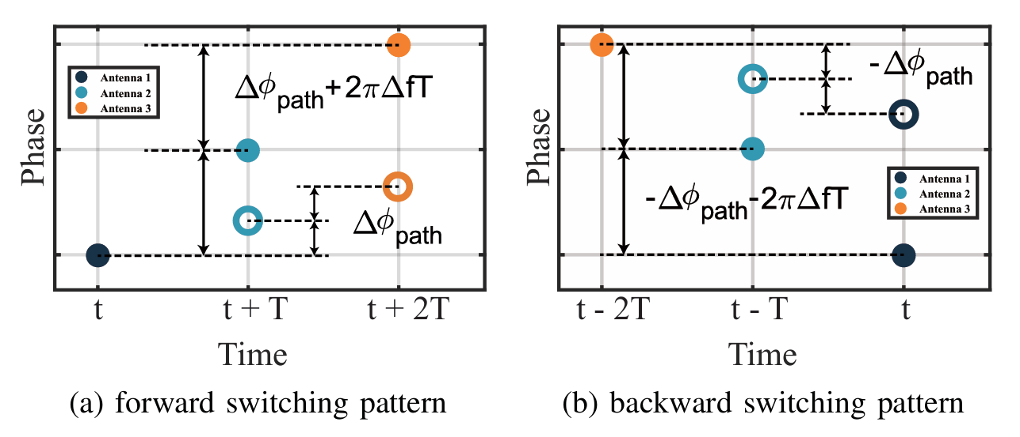
Reverse Antenna Scheduling
identical
switching
interval
Carrier frequency offset
the value of ∆f is the same but with opposite signs.
As long as the antennas are scheduled in a reversed manner, the signal phase difference caused by CFO will be reciprocal.
Notes:
In response to the factors that influence the reproductivity of BLE direction finding results,
we first design a reverse antenna scheduling module to cope with CFO.
Consider the central device as an antenna array and the peripheral devices with a single antenna:
When the central device is the transmitter and the peripheral device is the receiver, the angle of departure (AoD) of the signal can be calculated.
When the central device is the receiver and the peripheral device is the transmitter, the angle of arrival (AoA) of the signal can be calculated.
In these 2 cases, the phase difference is a combination of a combination of delta phi path and delta phi switch,
While delta phi path remains consistent and delta phi switch is proportional to delta f, which is the CFO
As the transmitter and receiver swaps in AoA/AoD probing,
the value of ∆f is the same but with opposite signs, which differentiates the measured delta phi.
(Although the CFO may drift due to changes in temperature and other factors,
it can be considered within the error margin during the brief time window of packet exchange.)
Fortunately, the sign of $\Delta\phi_{switch}$ depends
not only on that of the CFO but also on the sequence of antenna scheduling.
As shown in the figure, if we implement two exactly opposite switching patterns for the AoA/AoD probing process respectively,
the values of the overall phase difference $\Delta\phi$
become identical with the sign of $\Delta\phi_{switch}$ reversed.
Consequently, the phase measurement error caused by antenna switching and CFO can be reciprocal
when estimating AoA/AoD with the same device pair.
(Carrier frequency offset is caused by hardware defects in the local oscillator, creating a unique device fingerprint.
Most COTS devices share a local oscillator between the transmission and reception chains.)

Slide 12
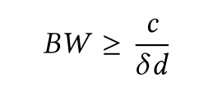
Noise Subspace Maximizing
classic MUSIC algorithm：suitable for incoherent signal sources
N>m>n
with a sample size of N, an array of m antennas, and n signal sources
for superposition of coherent signals in multipath propagation
Solution 1: Time of Flight (ToF)
Narrow bandwidth, low resolution
Solution 2: Spatial Smoothing algorithms
N>m>2i+j
Larger antenna array
Notes:
we then design a noise subspace maximizing module to deal with noise separation from coherent signal group.
Classic MUSIC algorithm has been widely leveraged to calculate the angle of signals.
With a sample size of capital N, an array of m antennas, and n signal sources,
the conditions N > m > n must be satisfied, and the n signal sources must be mutually incoherent.
However, in our cases, the signals with multi-path propagation forms a coherent group, and not resolvable with class algorithm.
To cope with that, The Time of Flight (ToF) of different paths can be used to extract the shortest path, but the narrow bandwidth of BLE results in extremely low resolution.
Likewise, there is the Spatial Smoothing algorithm designed to process coherent signals, but this requires deploying a larger number of antennas.
Fulfilling N>m>2i+j
Where i represents the number of coherent signals, and j represents the number of incoherent signals.

Slide 13
Noise Subspace Maximizing
classic MUSIC algorithm: eigenvalue decomposition on Rx, with eigenvalues in descending order
the first n’s eigenvectors → signal subspace others’→ noise subspace
eigenvectors corresponding to the non-dominant eigenvalues → the noise subspace
stable and reciprocal spatial spectrum under low SNR conditions
Notes:
To overcome these limitations, we propose noise subspace maximizing approach based on classic MUSIC algorithm.
Classic MUSIC performs eigenvalue decomposition on the autocorrelation matrix of the received signal samples,
And arrange the eigenvalues in descending order; the first n’s eigenvectors (corresponding to the number of signal sources) span the signal subspace,
while the remaining eigenvectors span the noise subspace. (These two subspaces are orthogonal to each other.)
In our case, as we are dealing with one coherent signal group,
we take all the eigenvectors corresponding to the non-dominant eigenvalues to span the noise subspace,
And as can be seen in the figure, we can derive more stable spatial spectrum
under low SNR condition compared to classic and spatial smoothing algorithms,
At the cost that the peaks of our pseudo-spectrum disagree the ground-truth direction.

Slide 14
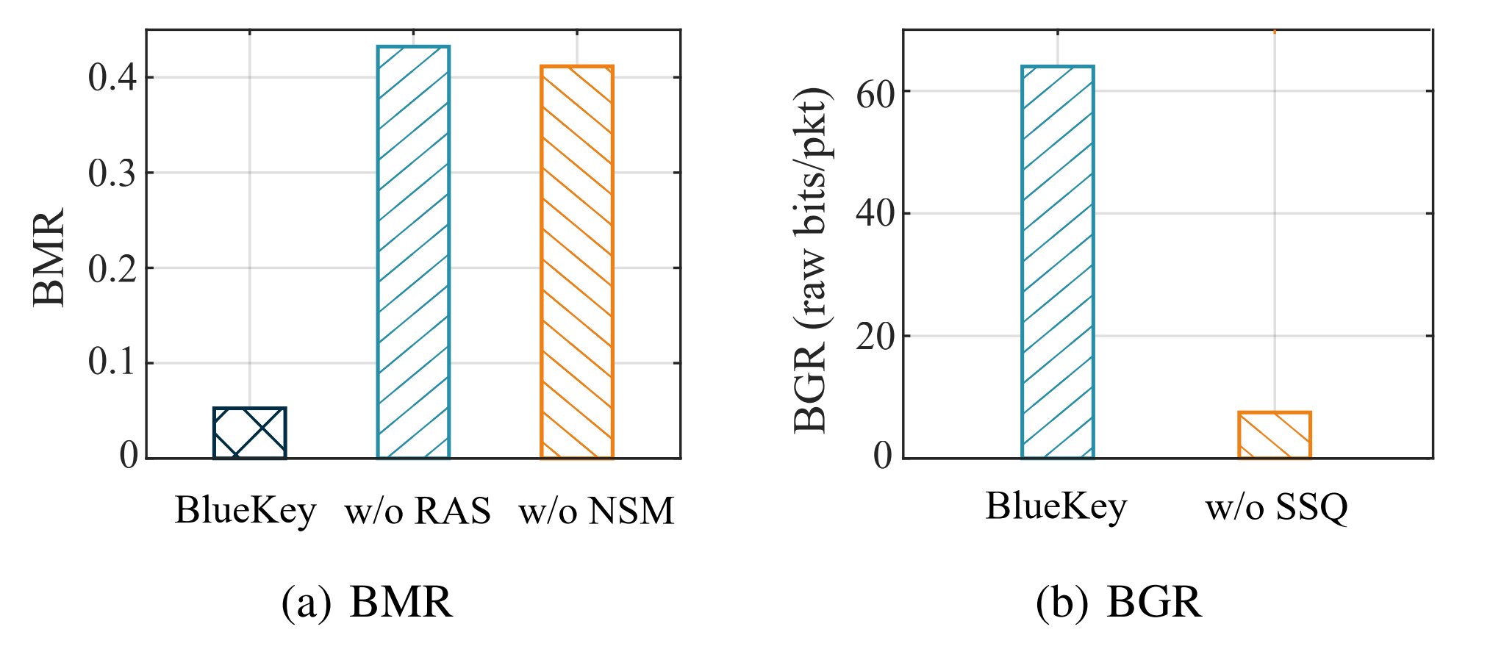
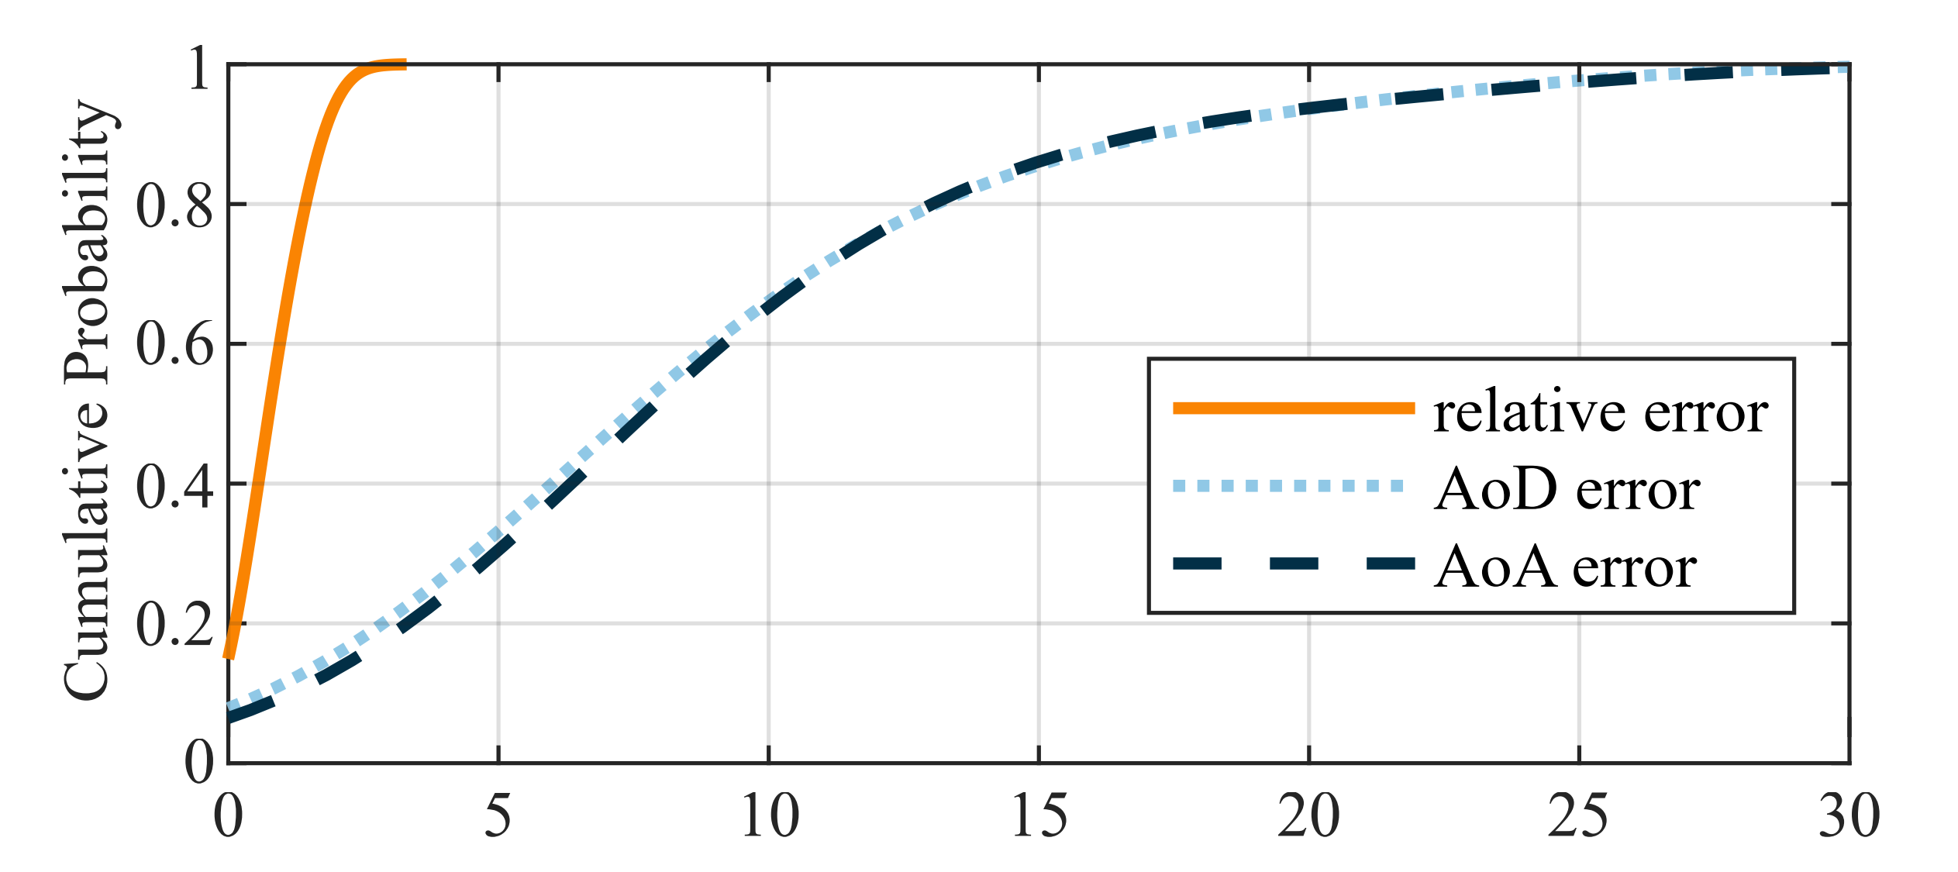
Reciprocal DoA errors
The errors are not eliminated,
but the reciprocity of AoA/AoD erroneous estimation is improved.
Evaluation Metric：BMR (Bit Mismatch Rate)
at which the raw bits generated between two devices do not match.
Correctness
Notes:
With the assistance reverse antenna scheduling to cope with CFO
and noise subspace maximizing to tackle noise,
We did not endeavor to eliminate the errors of BLE direction finding,
But improve the reciprocity of AoA and AoD erroneous estimation
in two independent channel probing process.
As is shown in the figure,
the median error of AoA/AoD compared to the groundtruth can reach 7-8°,
but the relative error of AoA/AoD is only about 0.7°.
And we manage to decrease the raw bit mismatch rate to smaller than 5%.

Slide 15
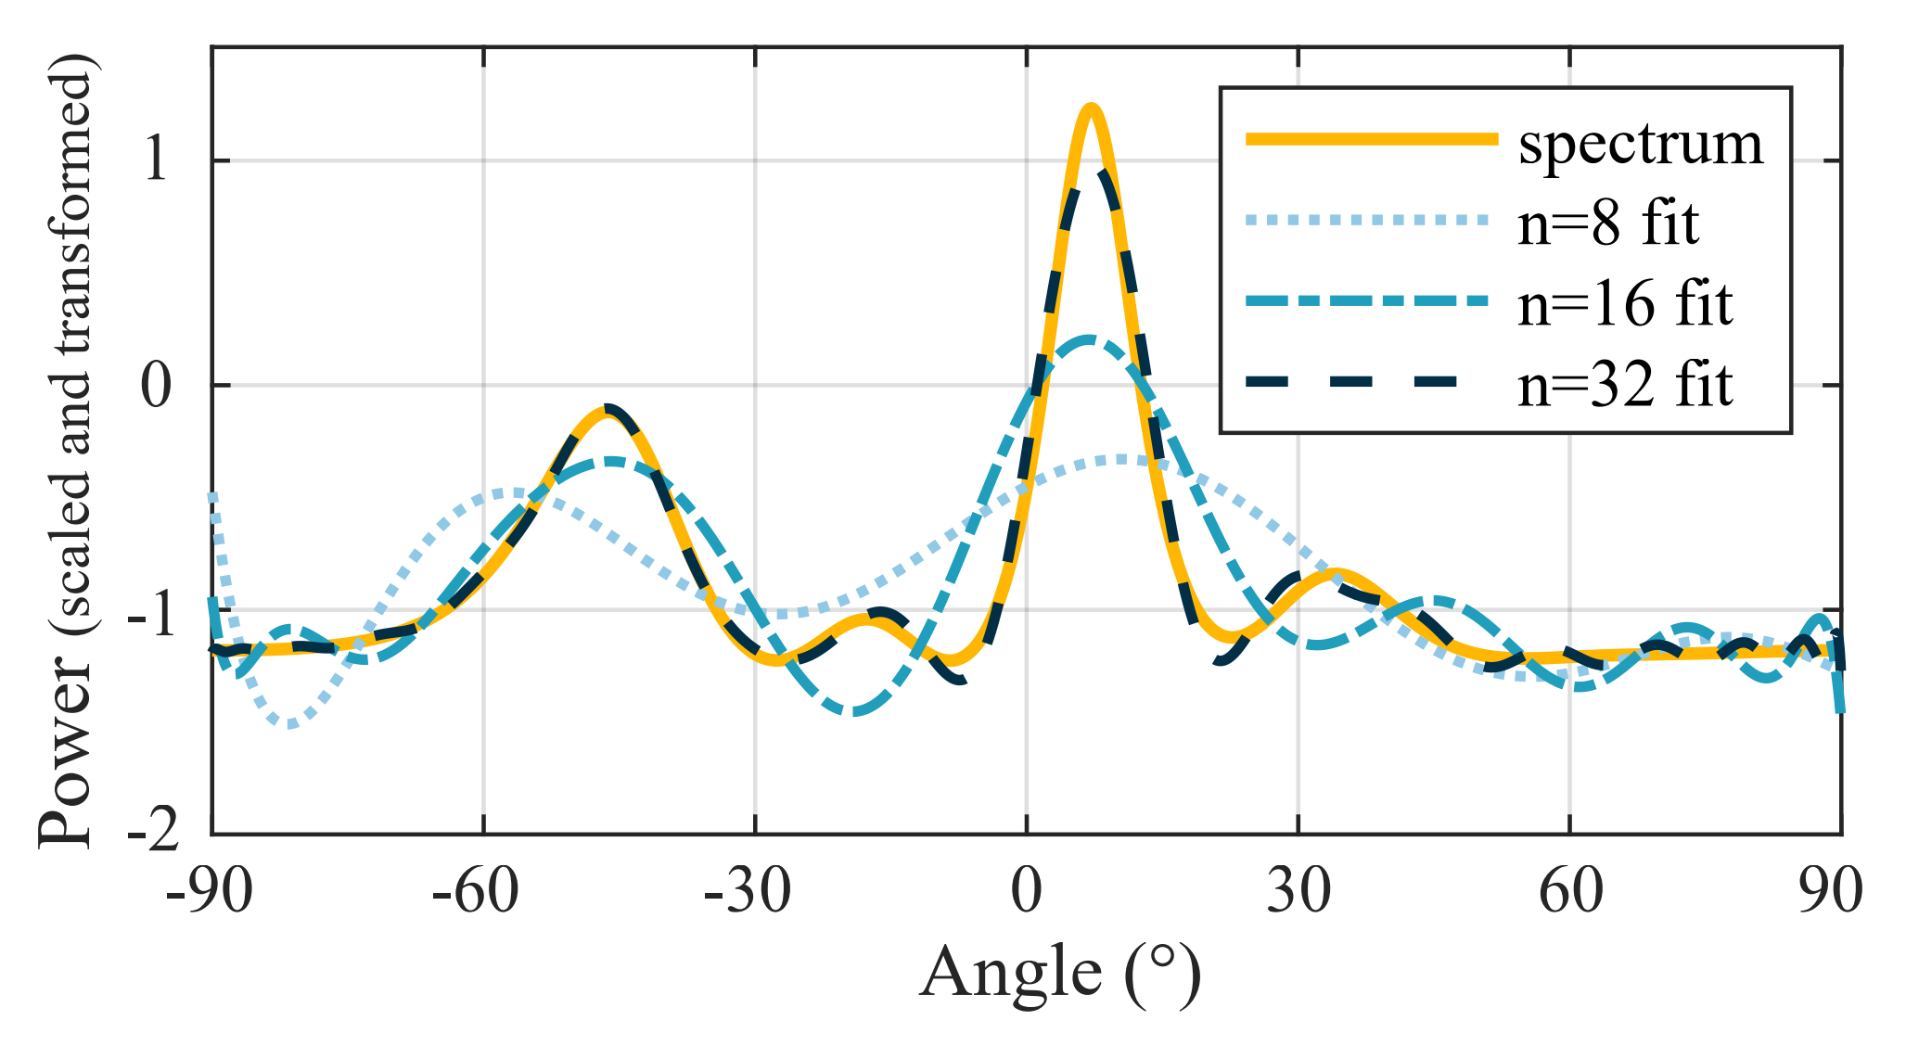
Spatial Spectrum Quantization
2. The reciprocal information is not limited to the peak angle estimates in the spatial spectrum.
Evaluation Metric：BGR (Bit Generation Rate)
at which the raw/secret bits are generated per data packet
Efficiency
Notes:
Also, we noticed that the usable reciprocal information is not limited to the peak angle estimates in the spatial spectrum.
When separating coherent signal groups and noise, multiple local maxima appear in the spatial spectrum.
If only the peak angles are extracted, a significant portion of the information entropy will be lost.
Therefore, we consider fitting the entire spatial spectrum by fitting it with orthogonal Legendre polynomials.
The coefficients of each term are adaptively quantized to maximally extract spatial information.
This spatial spectrum quantization method significantly increases the bit generation rate.
[Generation rate of raw bits (or secret bits after information reconciliation/privacy amplification).]

Slide 16
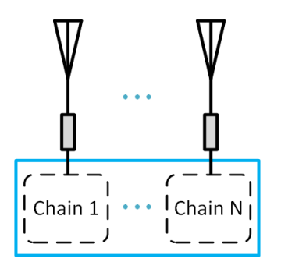
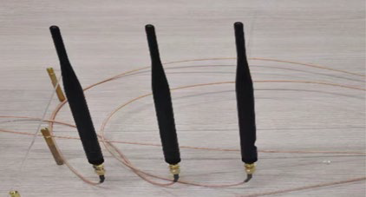
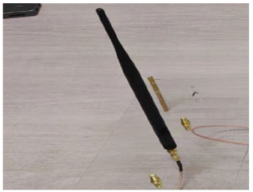
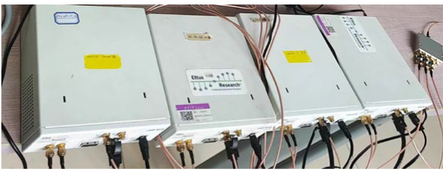
Experimental settings
Hardware setting：
Software Defined Radio (SDR) platform USRP-N210
UBX40 daughterboard
The central device consists of three USRPs that serve as RF links of a 3-antenna array
Another USRP as a single-antenna peripheral device
BLE packet setting：
Direction-finding packet type: ConnectionCTE
PHY transmission mode: LE1M
CTE field: length 72 μs, slot duration 2 μs, sample offset 8 μs
Notes:
We conducted experiments in SDR platform USRP-N210 with UBX40 daughterboard
(A single USRP N2xx has only one daughterboard, one transmission chain, and one reception chain.
An antenna array needs to be assembled to serve as the central device.)
The central device consists of three USRPs that serve as RF links of a 3-antenna array
And another USRP is utilized as a single-antenna peripheral device.
In addition,
We specified BLE packet signals with the parameters ConnectionCTE as the direction-finding packet type
and LE1M as the PHY transmission mode.
We generated and sampled IQ data of the CTE field
with the settings of 72 μs (millisecond) length, 2 μs slot duration, and 8 μs sample offset.

Slide 17
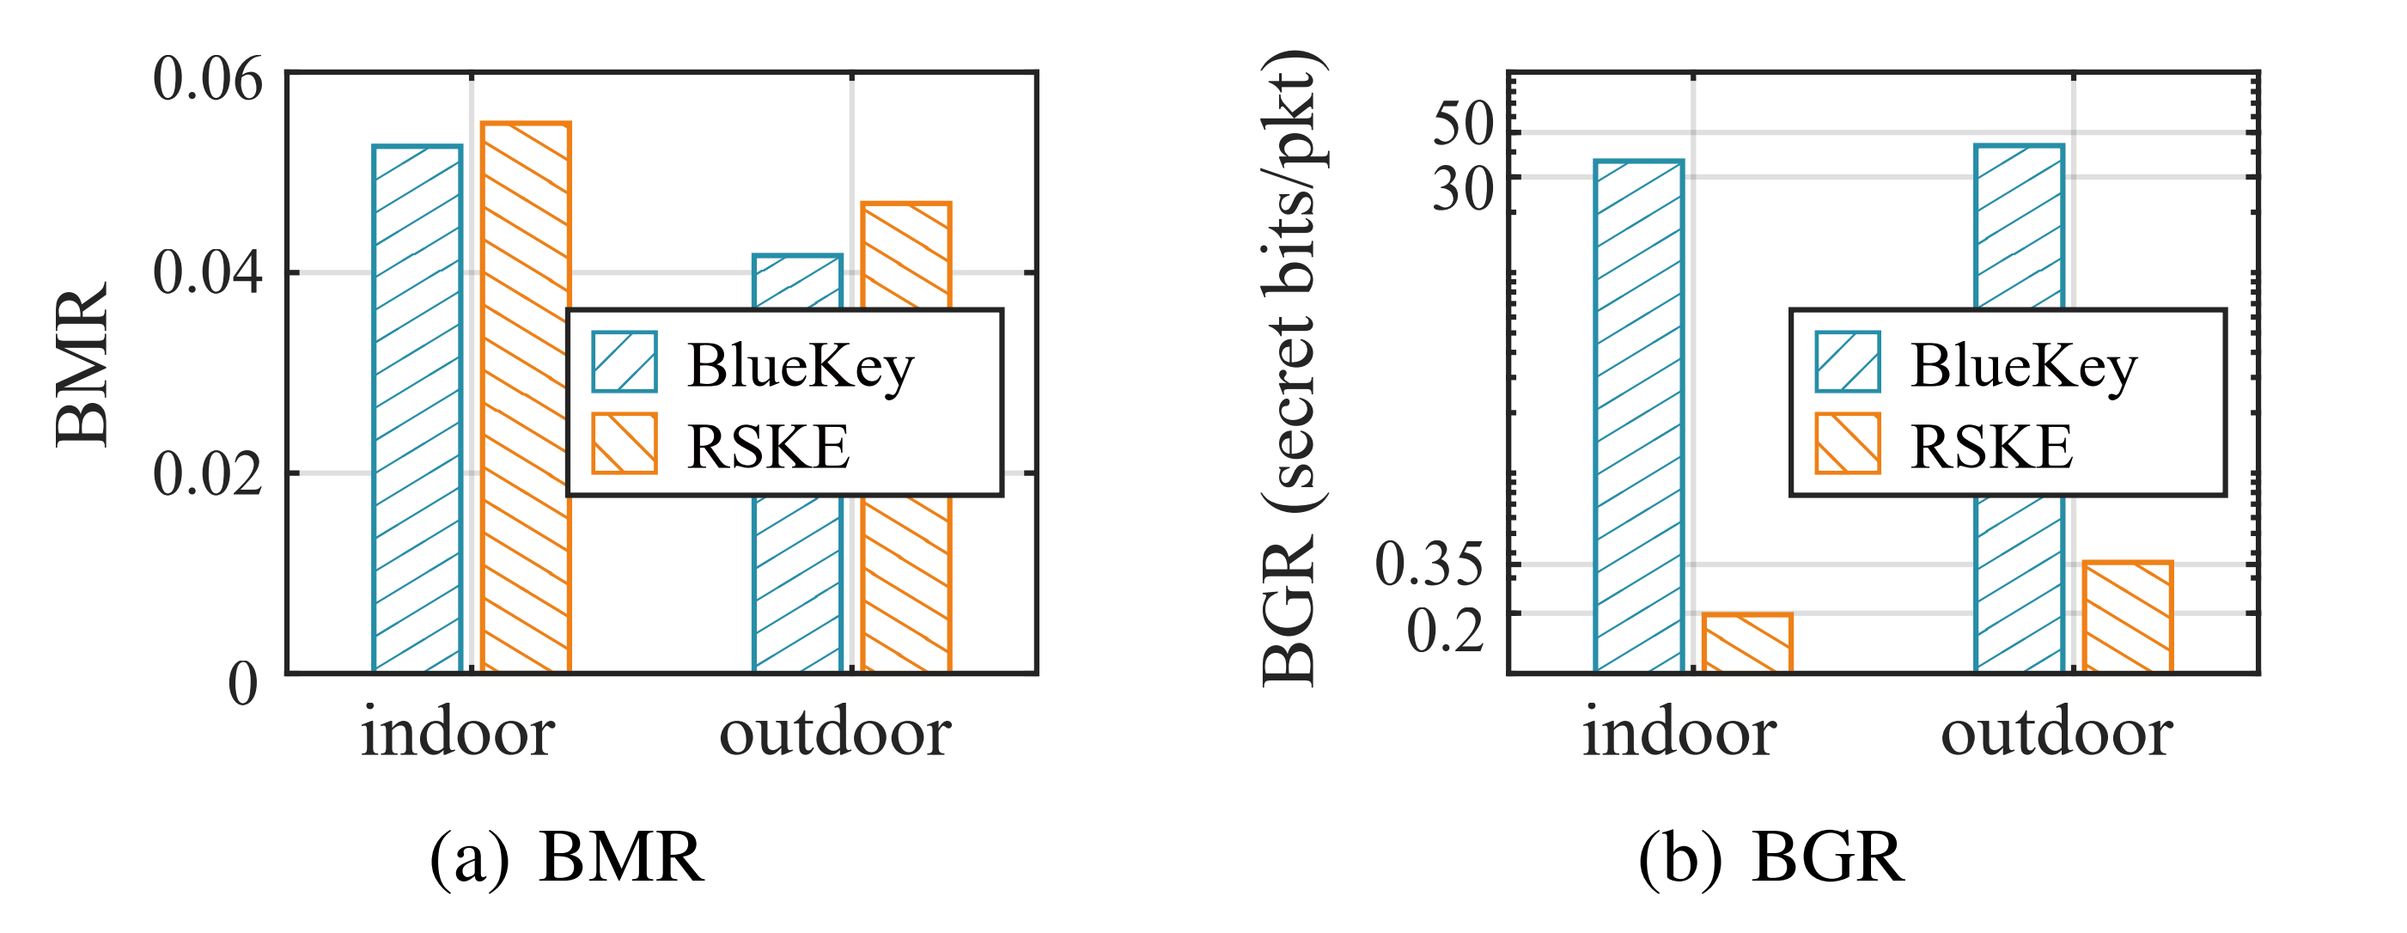
Experimental results
Compared to the SOTA Bluetooth PKG
the BMR decreased
by 4.19% (indoor) and 11.09% (outdoor)
the BGR increased
by 183.2× (indoor) and 119.9× (outdoor).
Notes:
Compared to the state-of-the-art Bluetooth physical layer key generation techniques
the BMR of Bluekey decreased by 4.19% in indoor sceario and 11.09% in outdoor scenario,
while the BGR increased by over 100 times both in indoor and outdoor scenarios.
Why BGR increase so much: PKG research on Bluetooth is very rare;
RSSI based, people walked around. RSSI between packets may not fluctuate so much.
Instead we measure in a temporary static environment and extract the multipath spatial information.

Slide 18
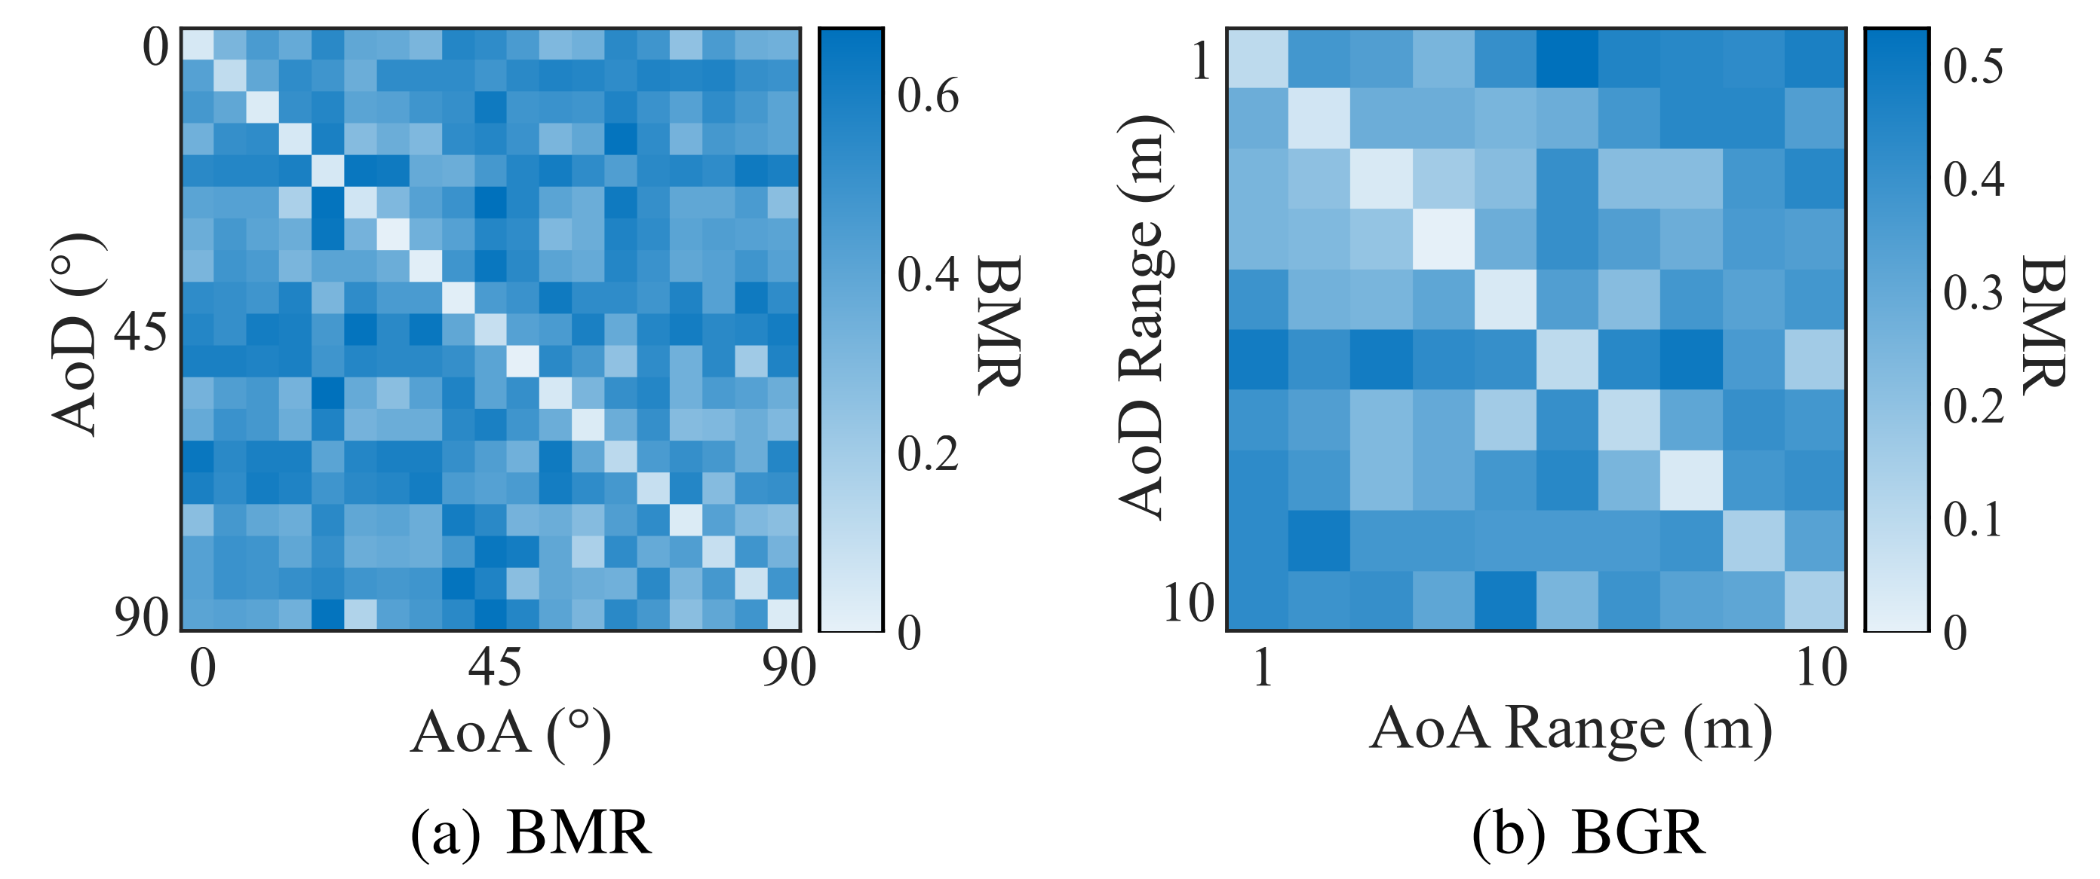
Experimental results
Impact of radial/tangential positions of peripheral (legitimate/eavesdropping) devices：
At a communication distance of 1 meter,
an angular resolution of less than 5° can be achieved (approximately equivalent to 8.73 cm).
With a fixed angle,
the distance resolution is around 1 meter.
The difference between adjacent positions is less significant
compared to when the signal direction changes.
Notes:
We also examine the impact of radial/tangential positions of peripheral (legitimate/eavesdropping) devices:
At a communication distance of 1 meter, an angular resolution of less than 5° can be achieved (approximately equivalent to 8.73 cm).
With a fixed angle, the distance resolution is around 1 meter.
The difference between adjacent positions is less significant compared to when the signal direction changes.

Slide 19
Security Analysis
Eavesdropping Attack Receive signals from adjacent positions
Position Replay Attack Move to the historical position of the legitimate device
Predictable Channel Attack Create regular alternating LoS and NLoS channels between legitimate devices
Out-of-Band Attack Use visual cues to detect relative positions and fake the spatial spectrum
Notes:
Last but not least, we
Eavesdropping Attack: Receive signals from adjacent positions and extract physical layer information. Position Replay Attack: Move to the historical position of the legitimate device to probe the spatial spectrum. Predictable Channel Attack: Create regular alternating LoS and NLoS channels between legitimate devices Out-of-Band Attack: Use out-of-band methods, such as visual cues, to determine the relative position of the legitimate device and fake the spatial spectrum.

Slide 20
Conclusion
Innovative PKG solution for Bluetooth:
First to leverage CTE without additional overhead.
Simplifies hardware requirements, ideal for low-power IoT setups.
Orthogonal Polynomial Quantization for Enhanced Security:
A novel method to generate and utilize the reciprocal spatial spectra.
Optimized for GFSK modulation of BLE.
Extensive Validation through SDR Experiments:
Comprehensive testing demonstrates a significant increase in BGR.
Confirms the system's practicality and robustness.
Notes:
Innovative PKG solution for Bluetooth:
Bluekey is the first to leverage CTE to extract critical physical-layer information without additional overhead.
We Simplify hardware requirements, with single-antenna peripheral devices, ideal for low-power IoT setups.
Orthogonal Polynomial Quantization for Enhanced Security:
We Develop a novel quantization method to enable precise AoA and AoD calculations, maximizing the noise subspace and utilizing the full spectrum for PKG.
It is optimized for GFSK modulation, eliminating the need for complex direction-finding algorithms.
Extensive Validation through SDR Experiments:
Comprehensive testing on an SDR platform demonstrates a significant increase in key generation rates.
It confirms the system's practicality and introduces a robust solution for BLE security challenges.

Slide 21
Thanks for Listening
Notes:
These will conclude my talk. Thank you for your time.

